Slide 1
Bootstrap Masterclass
Awesome websites for everyone!

Slide 2
Getting Started:
Go to www.looplearning.io and hit join class. The code is bootstrapper.
Download the skeleton folder from www.bit.do/hatchery-bootstrapper.
In Brackets, go to file -> open folder -> (then select the skeleton folder).

Slide 3
What is Bootstrap?
Why was it created?

Slide 4
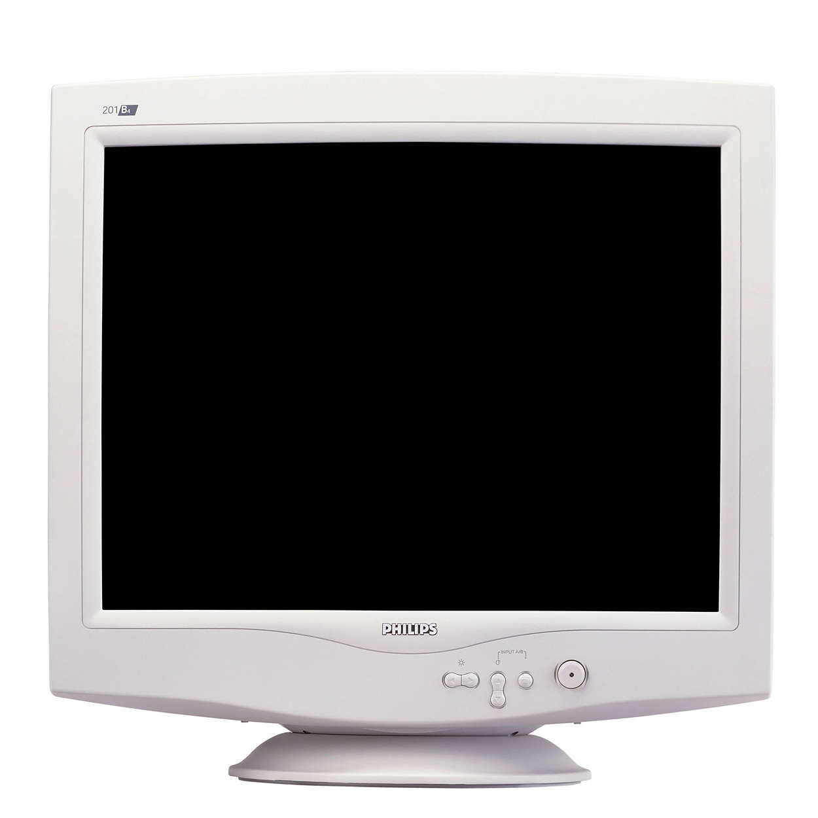
Back in the old days...
This was how you viewed a website --->
One screen size
One screen shape
Navigation with a mouse and keyboard

Slide 5
Life was easy for web developers!

Slide 6
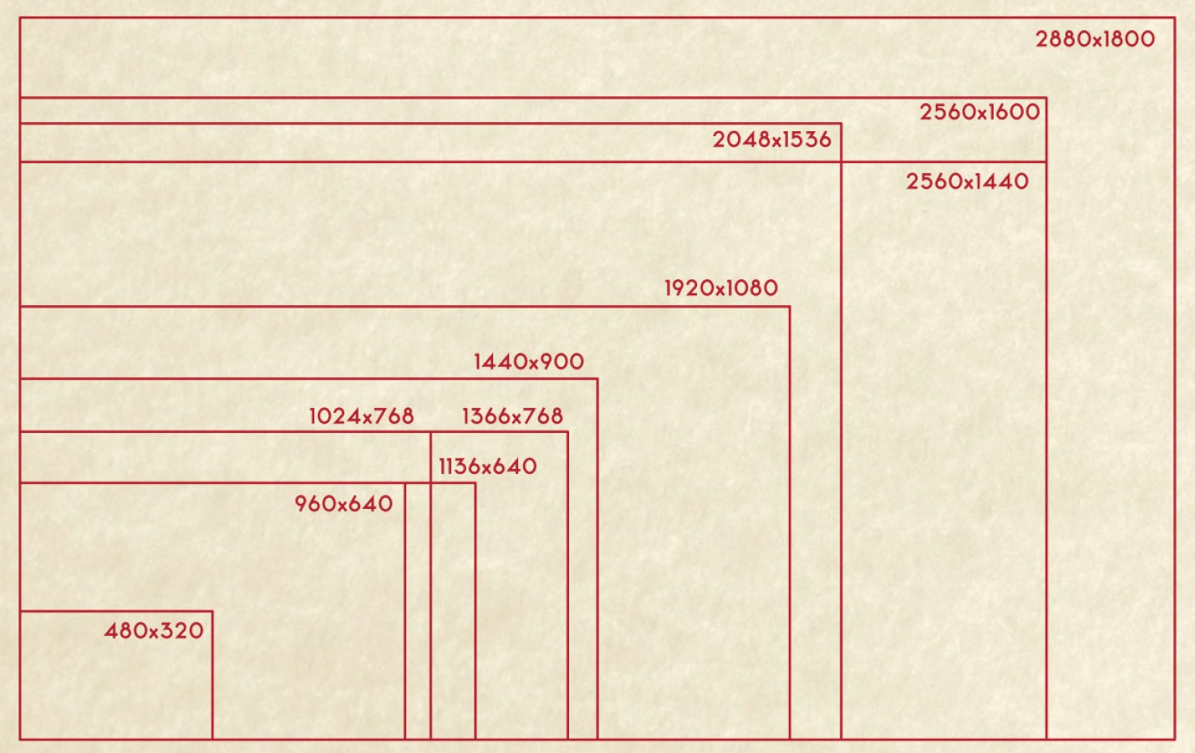
The modern environment
We can’t really pick a “standard size” anymore
Different input mechanisms
Landscape/Portrait
Some people have fibre connections, others have a 2G mobile hotspot

Slide 7
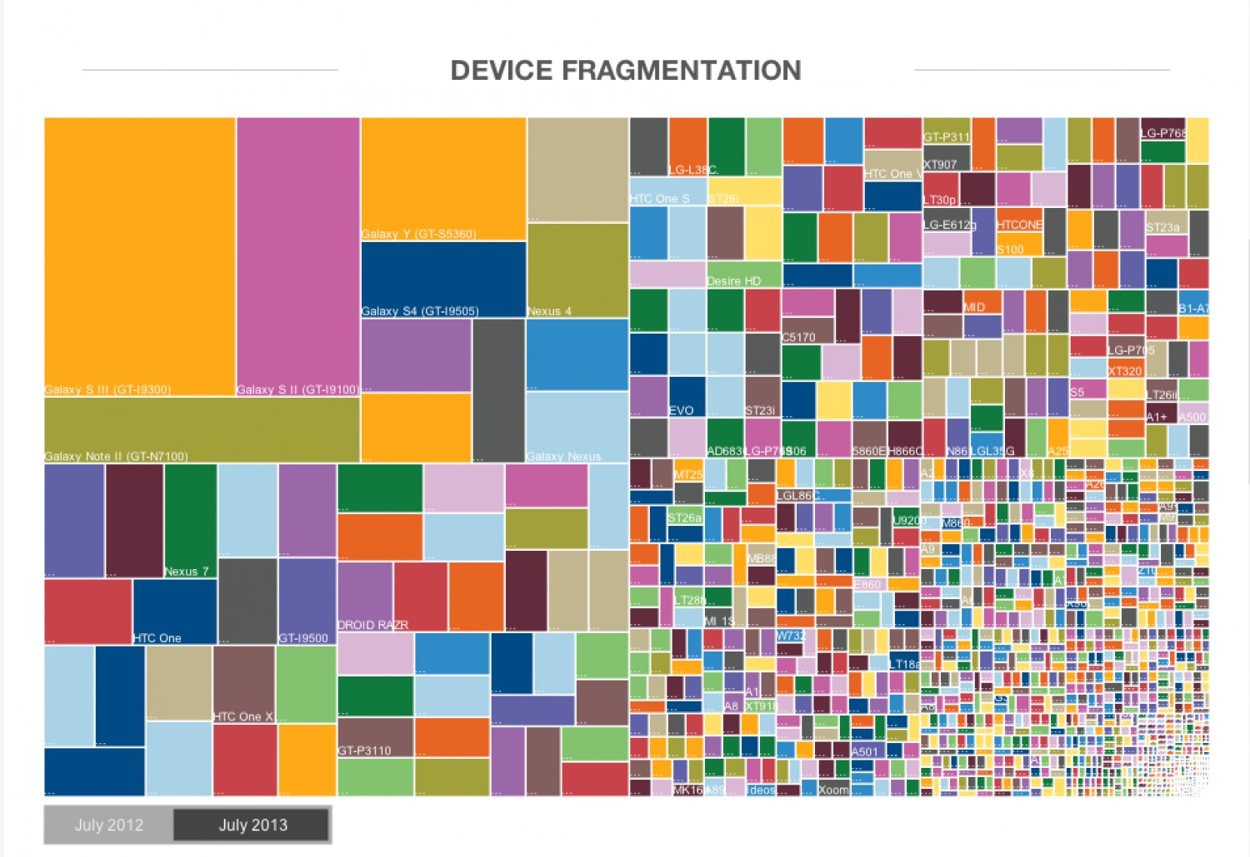

Slide 8
How can we create websites that look awesome on any device?

Slide 9
With Responsive Design!

Slide 10
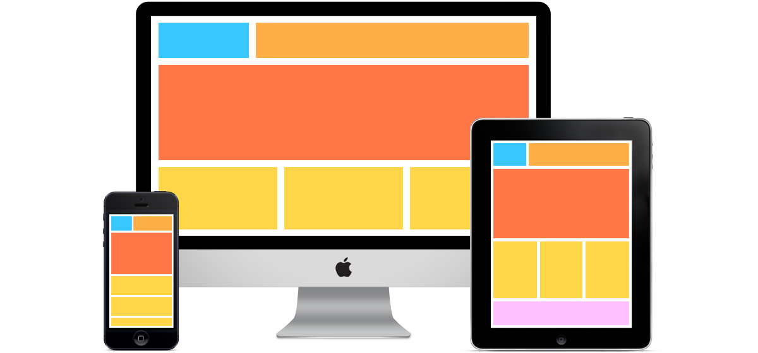
What is Responsive Design?
It’s a design approach that focuses on providing a good user experience for people using a wide range of different types of devices in a multitude of different ways.

Slide 11
We can do this in HTML5 and CSS3
Media queries, flex boxes and other CSS3 features let us dynamically change how a page is displayed based on the size of the browser window.
Responsive design is half of what modern Bootstrap does.

Slide 12
Let’s go back in time...
Bootstrap wasn’t always about responsiveness

Slide 13
Originally a style guide
The original Bootstrap contained implementations for things like buttons and menus to keep styling consistent across Twitter.
Bootstrap V2 - Optionally responsive
Bootstrap V3 - Designed to be responsive and “mobile-first”
Bootstrap V4 is on the way with improvements!

Slide 14
Bootstrap is:
Responsiveness
+
Consistent Styling

Slide 15
Our big box of Lego blocks!
Modern Bootstrap is a big CSS file filled with clean solutions to common problems
It includes styling for:
Buttons
Responsiveness by default
Menus
Typography + glyphs
Progress bars
Neat tables

Slide 16
12
Bootstrap breaks every screen into
columns

Slide 17
On a Large Screen
container-fluid
row
col-lg-4 col-sm-12
col-lg-8 col-sm-12

Slide 18
On a Small Screen
col-lg-4 col-sm-12
col-lg-8 col-sm-12

Slide 19
Questions?

Slide 20
Remember:
Go to www.looplearning.com and hit join class. The code is bootstrapper.
Download the skeleton folder from www.bit.do/hatchery-bootstrapper.
In Brackets, go to file -> open folder -> (then select the skeleton folder).

